Slide 2
Somos Amigos/ we are friends/ 我们都是朋友
Please use two to three sentence to introduce yourself in at least two language
Including but not limited to :
Your name
Your Age
The city & Country you are currently resident
What is your favorite things which like to share with our club?
Utilice dos o tres oraciones para presentarse en al menos dos idiomas.
Incluyendo pero no limitado a :
Su nombre
Su edad
La ciudad y el país en el que reside actualmente
¿Cuáles son tus cosas favoritas que te gusta compartir con nuestro club?
请用两三句话介绍你自己，可以包括但是不限制于：
你的名字，
你的年龄
你现在居住的城市和国家
你有什么特别喜爱的事物和大家分享？

Slide 3
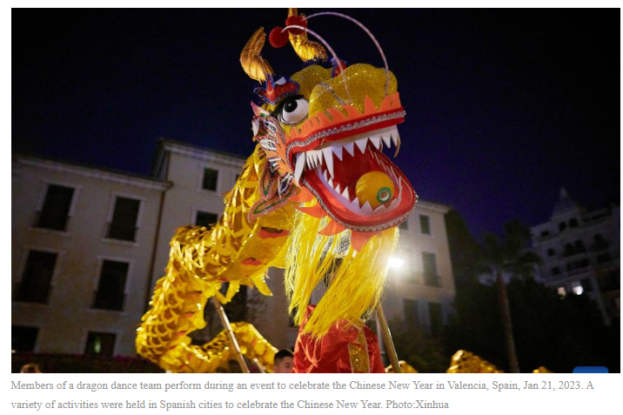
Happy Chinese New Year
When is the Chinese New Year 2024?
Dates, what animal is this year and what does it mean?
The Chinese New Year is an ancient celebration that marks the beginning of a new lunar cycle and culturally represents a rebirth, full of deep-rooted traditions and ancestral symbolism. In the Chinese calendar, the year 2024 will give way to the year of the Dragon, a symbol of great significance in Chinese cosmology.
Every time a new period begins, the question of when the Chinese New Year begins and the meaning of this traditional celebration, also known as Spring Festival, begins to arise; therefore, we present all the information for you to find out about this festivity.

Slide 4
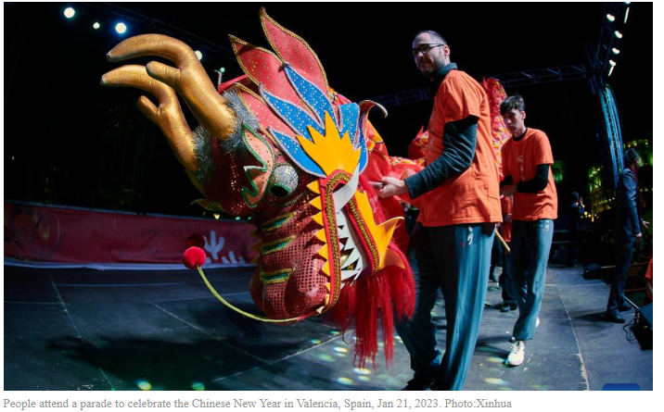
Happy Chinese New Year
Chinese New Year 2024 Start Date
The Chinese New Year holiday is based on the lunar calendar and therefore varies each year on the Gregorian calendar. In 2024, the Chinese New Year celebration will begin on February 10. The festivities include colorful parades, lion and dragon dances, family reunions, exchange of red envelopes (with money inside as a symbol of good fortune), banquets with traditional dishes and the display of fireworks.
When the Chinese New Year is ascribed to the sign of the dragon, it portends a year of intense energy and significant change.

Slide 5
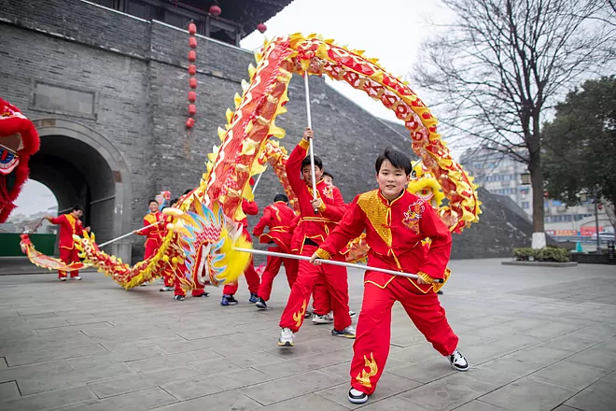
Happy Chinese New Year
What does the year of the Dragon mean in Asian culture?
In the Chinese worldview, the dragon is not perceived as a fearsome creature, but as a divine being that bestows power and good fortune. It is associated with positive characteristics such as wisdom, vitality, nobility and benevolence. He represents primordial strength, prosperity, courage and renewal.
This legendary mythological being is much more than just a creature in Chinese folklore. It is believed that the emperors were descendants of the dragon, thus symbolizing imperial power. In addition, the dragon is considered to have control over natural phenomena such as rain, essential for agriculture, and is credited with the power to generate abundance and fertility in the land.

Slide 6
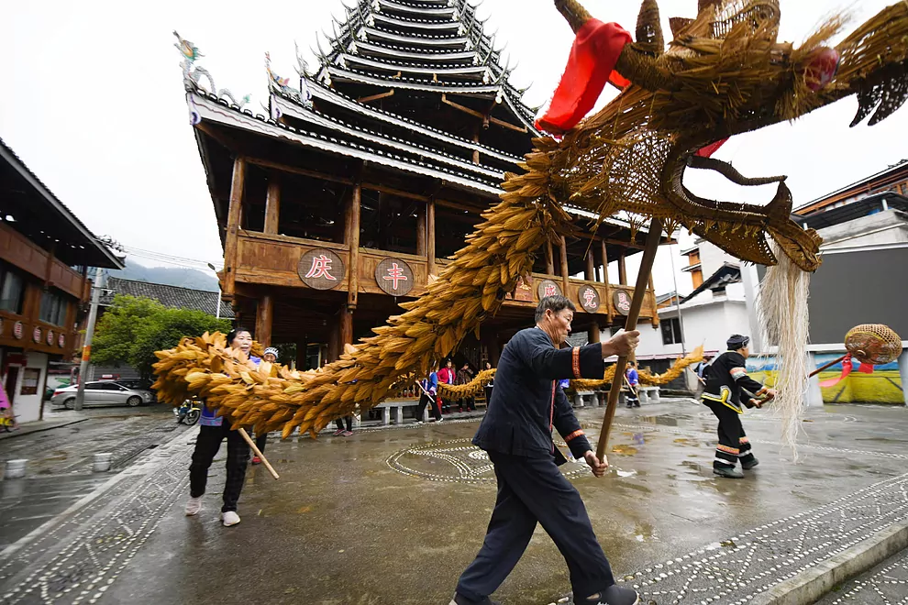
Happy Chinese New Year/
What we will do in Chinese New year
https://www.youtube.com/watch?v=3pv7mGnm7nM

Slide 7
Happy Chinese New Year/
How to say “ Happy Chinese New year “ In
English
Spanish
Chinese
https://www.youtube.com/watch?v=R05_0VOPkts

Slide 8
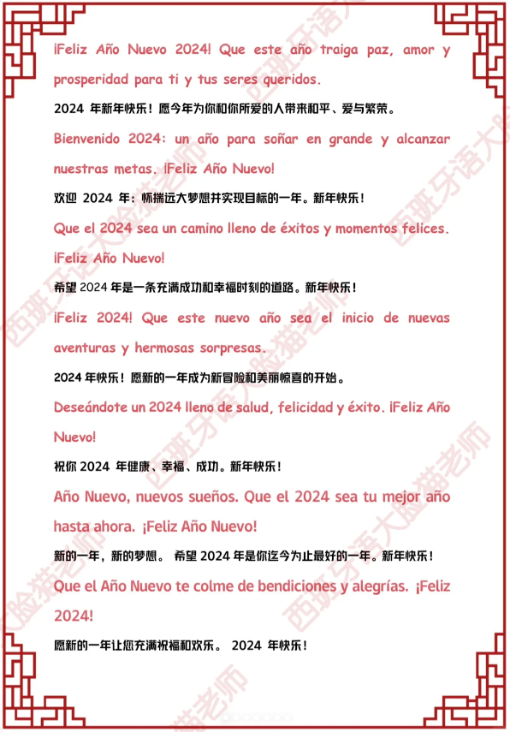
Happy Chinese New Year/

Slide 9
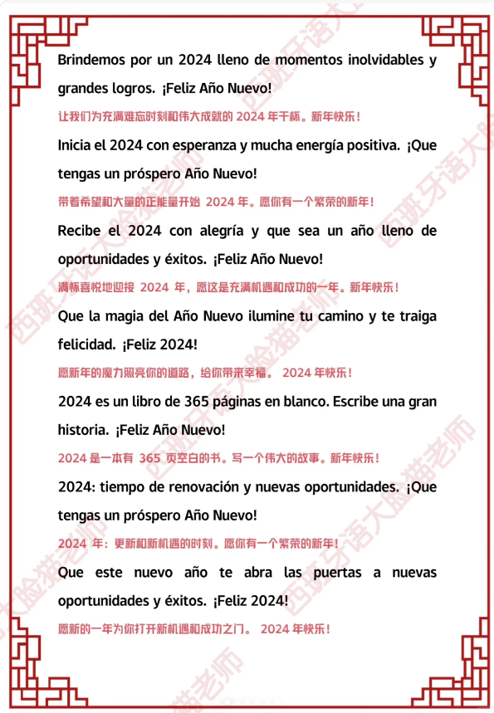
Happy Chinese New Year/

Slide 10
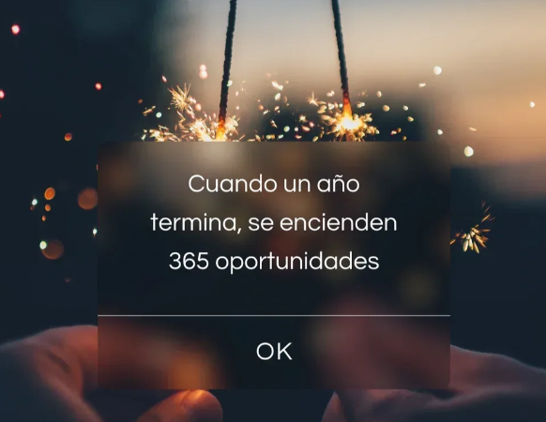
Happy Chinese New Year

Slide 11
Happy Chinese New Year
Chinese New Year celebration Event in San Diego ,CA
Balboa Park , House of China
DATE: February 17 & 18
TIME: 11:00 am - 5:00 pm

Slide 12
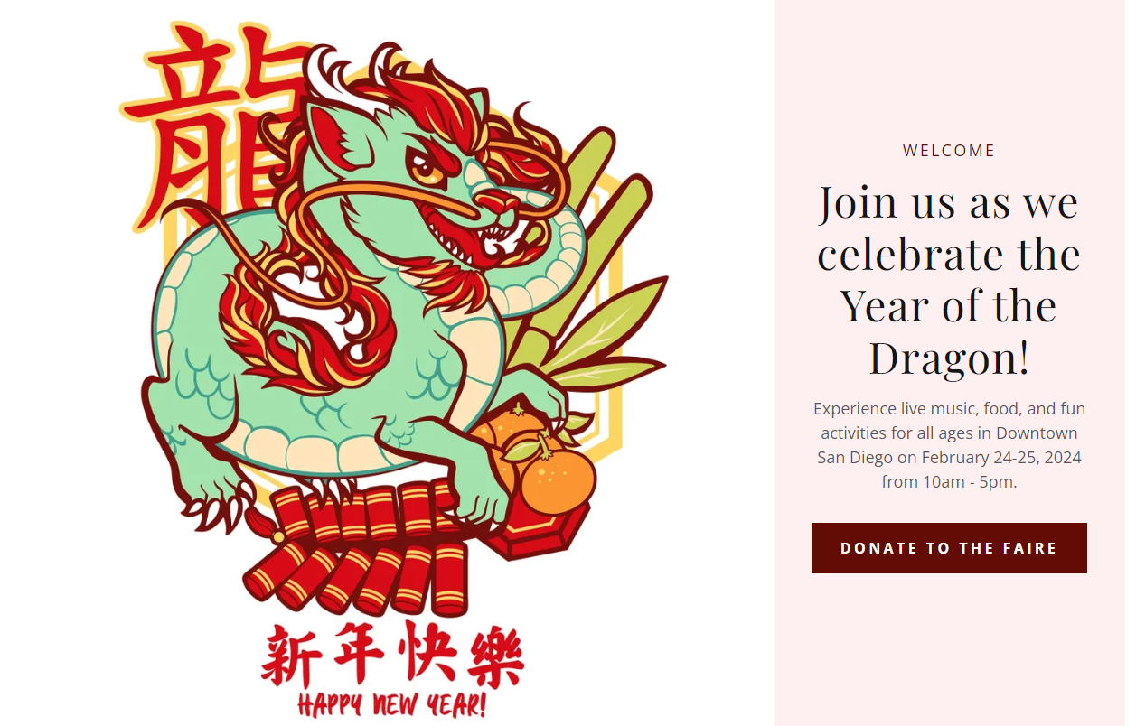
Happy Chinese New Year/
Chinese New Year celebration Event in San Diego ,CA
Downtown San Diego on February 24-25, 2024 from 10am - 5pm.

Slide 13
ESC Club Website -Teaching Plan
Alex Teaching Plan:
Logo for kids
Mario Teaching Plan:
Match for Kids

