Slide 1
ESC Club Annual Plan
Present by Helen Fang

Slide 2
DELE TEACHING PLAN 2023-2024
https://docs.google.com/document/d/1hEZxNjVzq1wLQOmM-4GPo0JumCZiQPsWSQ4vBvm7wLM/edit?usp=sharing

Slide 3
Mission Statement
Improve club members Spanish language skills
Prepare for DELE & AP Spanish test
Develop member leadership
Help member outreach capability
Using their Language skill to practice with community service
Learn, Grow and Impact

Slide 4
Improvement Member Language skill
Saturday DELE Class - Mr. Diego
Class Syllabus
HW each week
Google Classroom for each HW assignment and submission
Quizlet each week
Each Club member prepare one Topic for WK Club night presentation
Ex: Alex for Robotic FLL competition.
Club member need prepare Slides in Both English and Spanish.
Submit to the Google Classroom Before the Club night .

Slide 5
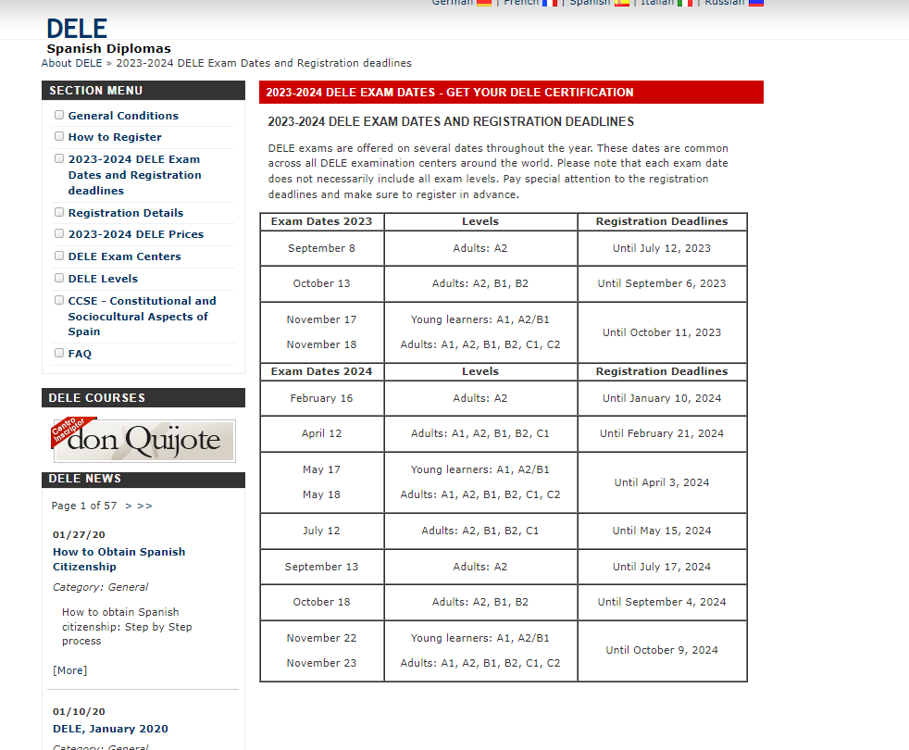
Prepare For DELE & AP Spanish test
Take Test at Grace School- Mr. Diego
Test Schedule
Mock Test arrangements
Two level A2/ B1
Target Time Nov 2023/ May 2024

Slide 6
Prepare For DELE & AP Spanish Test
DELE equal to two years foreign language request for college application - Mr. Diego
Grace School is working with each district in San Diego and try to setup DELE equivalent to Two years credits.

Slide 7
Develop member leadership
Setup ESC Club Board Team
Arrange all budgeting and schedule
Planning Club night activities
Planning Field trip activities
Scheduling Monthly and Quarterly outreach activities

Slide 8
Develop member leadership
Weekly Club night Webinar
Each week one talk
Member select the topic to the club Board two weeks in advance
Club Board help to arrange the talk schedule
Each member response for Their Own Slides
Each member response for speachk practice in Spanish and English
Club Board will select guest speaker come to Club night webinar

Slide 9
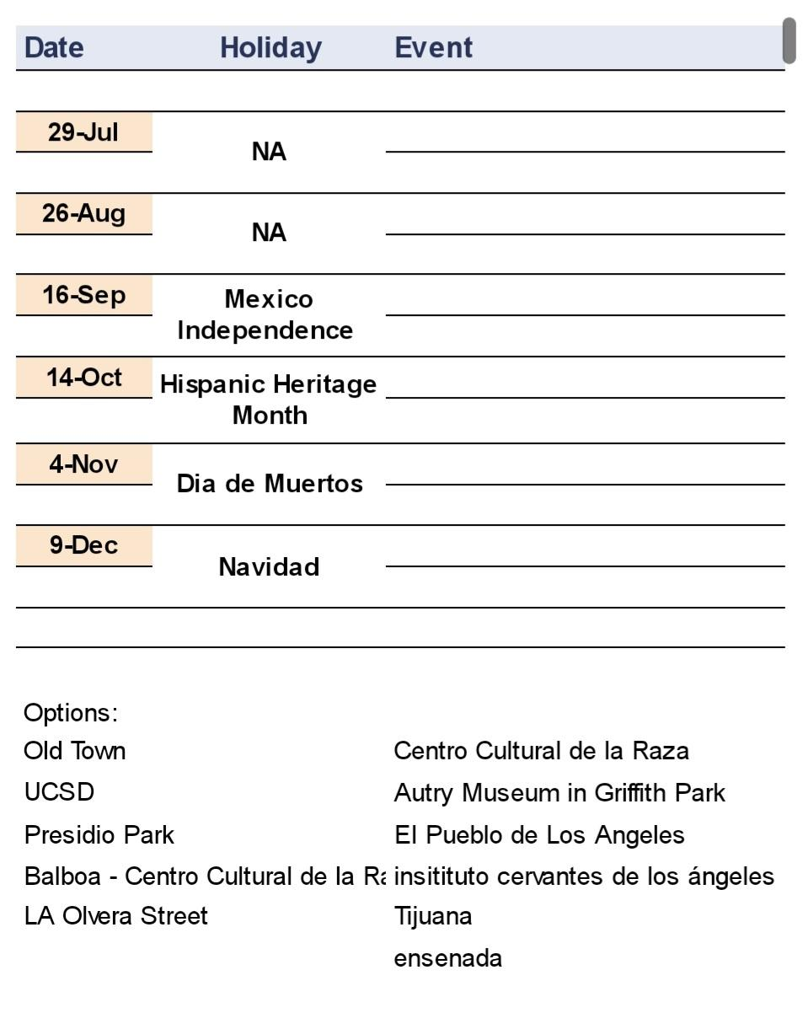
Develop member leadership
Monthly Field Trip

Slide 10
Help member outreach capability
Research outreach plan online
Customized the outreach plan for our ESC Club
http://wymancenter.org/wp-content/uploads/2015/10/Special-Population-Resource-Final.pdf
https://www.co.monterey.ca.us/government/departments-a-h/health/behavioral-health/bh-home/community-resources/young-adult-resources
https://www.countyofsb.org/270/Outreach-Community-Development
https://www.huduser.gov/portal/publications/pdf/lessons_complete.pdf

Slide 11
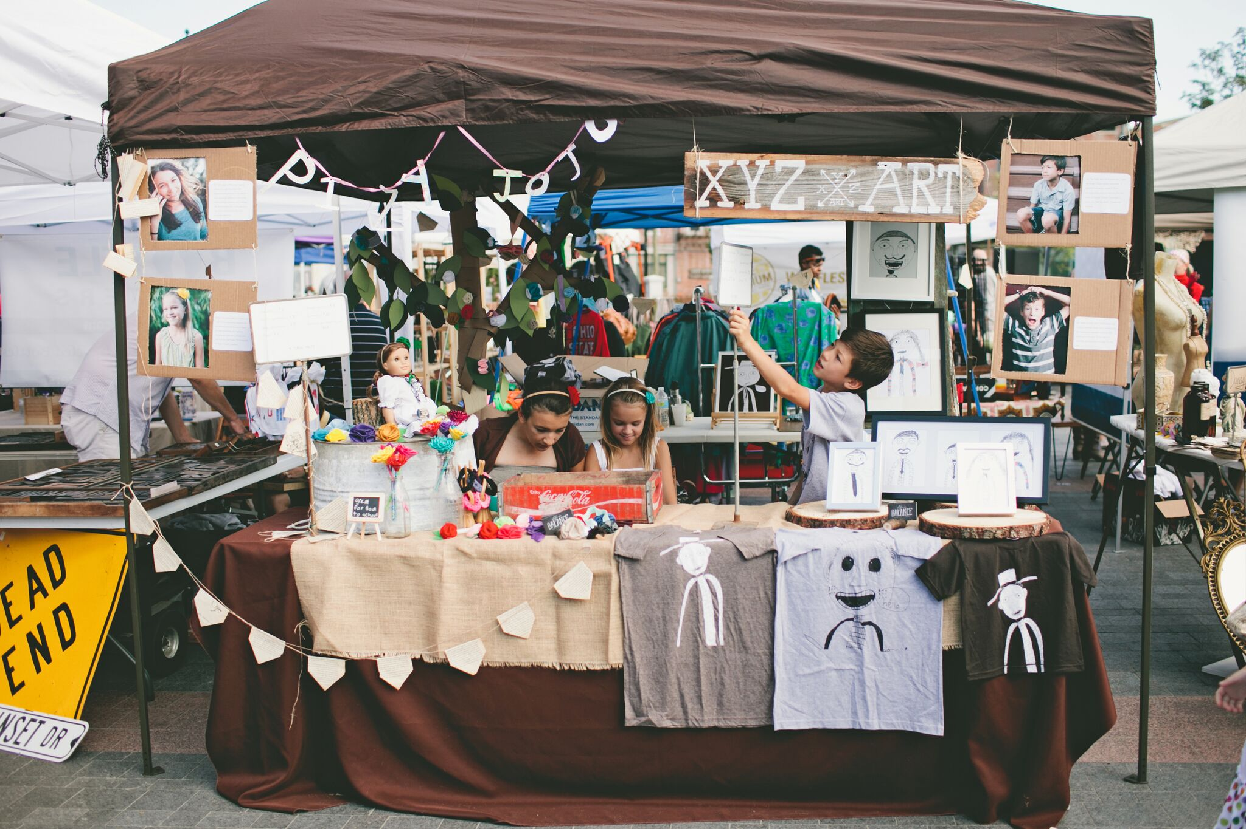
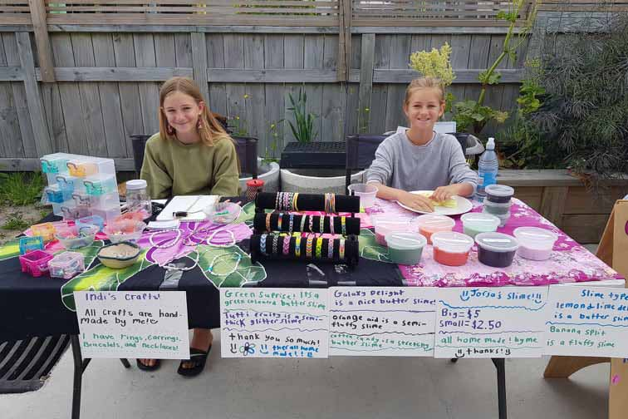
Help member outreach capability
Fundraising
Board discuss for fundraising
Budgeting setup and expenditure plan setup
Actions Vs follow up
SEP 2023 Fundraising-
Flea Market for kids
Date selections 09/02 ?
Partner
Location - Grace school gym
Formating

Slide 12
Using their Language skill to practice with community service
Subchapter in each school
Tutoring class setup
Developing Subchapter in Each school
Developing Tutoring Class - Math Class, Python Class, Robotic Class. Chinese Class, English Class.
Website and Social media setup-youtube channel, Facebook, ins, Discord.

